Slide 1
NutriCulinary System
Submitted by -
Tanzila Khan (25)
Muhaiminul Islam Ninad (43)
Submitted to -
Abu Ahmed Ferdaus
Associate Professor, Department of Computer Science and Engineering
University of Dhaka
Dr. Md Mamun-Or-Rashid
Professor, Department of Computer Science and Engineering
University of Dhaka
Presentation Date - 10 March, 2025

Slide 2
NutriCulinary System Features
Implemented user interface with Next.js and stored the data set in Supabase
Features:
Keeps track of what ingredients users can't eat
Stores cooking recipes with clear steps
Shows recipes that match user’s diet goals
Tells users exactly how much calories, protein, fat, and carbs are in each meal
Gives step-by-step cooking instructions with timing
Lets users set limits for calories, protein, carbs, and fat per meal
Helps users find recipes based on ingredients they have
Lets users follow specific diets

Slide 3
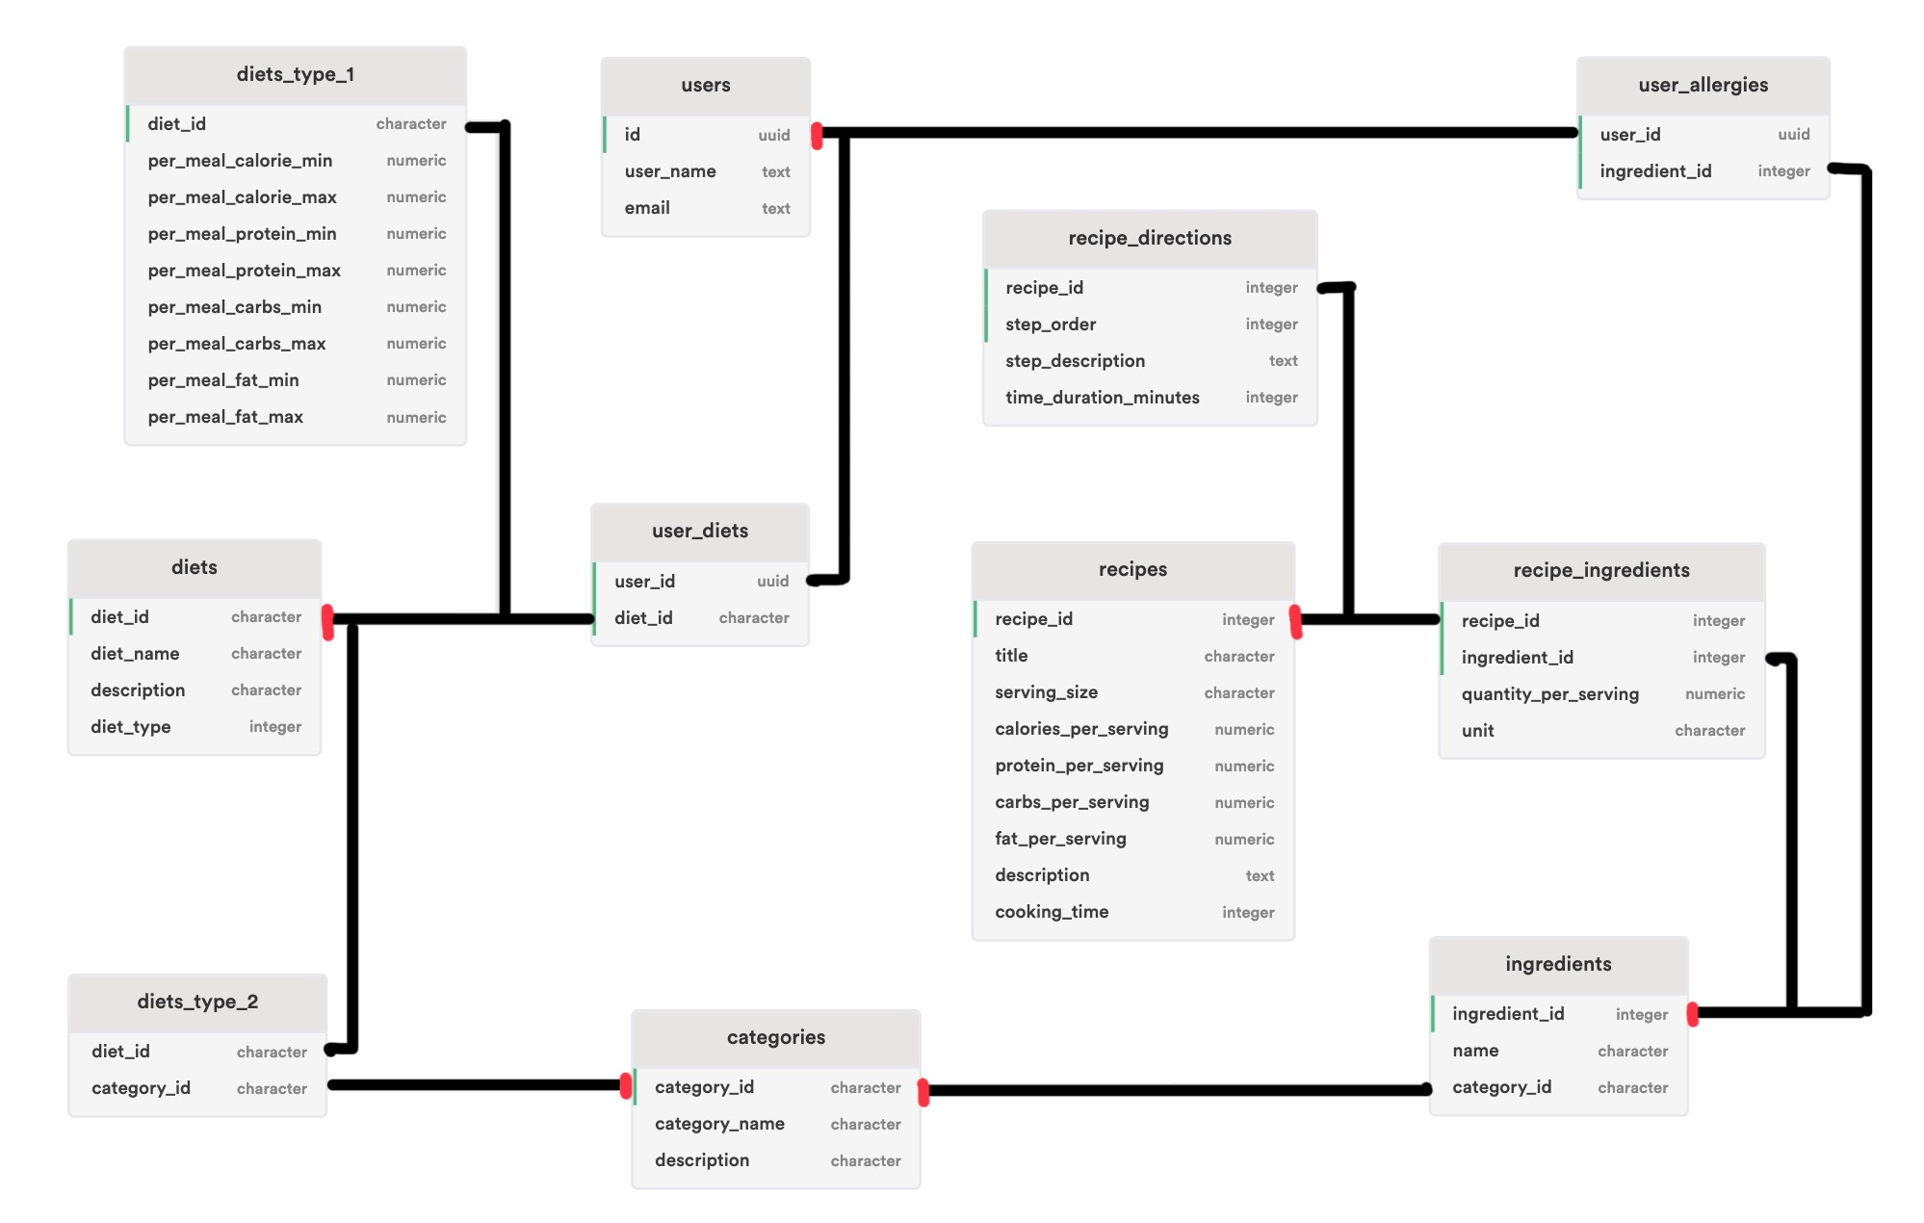
Schema Diagram
Rectangles: tables with names
Fields: Listed with respective data types
Primary Keys: vertical green lines along the left edge of fields
Connecting Lines: relationships between tables
Red Symbols: Mark the parent/primary key side of relationships

Slide 4
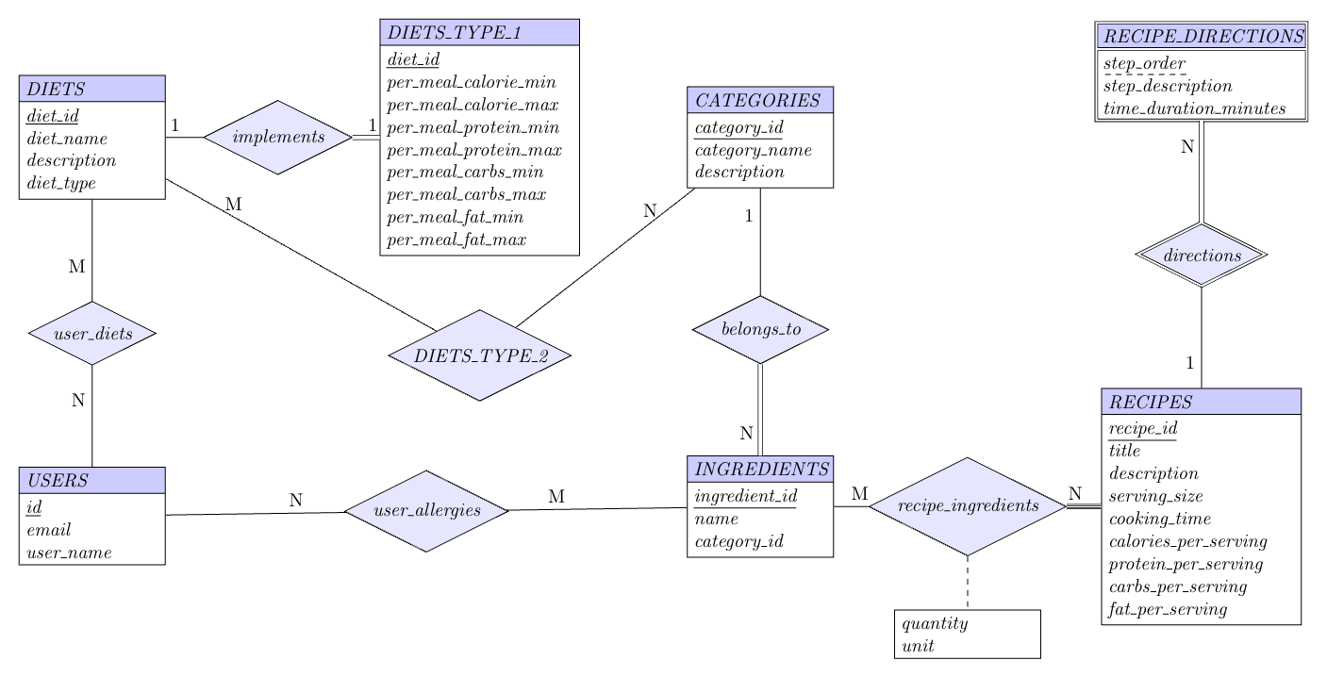
E-R Diagram

Slide 5
Normal Form Analysis
1NF
3NF
All tables satisfy 1NF
Atomic values only
No repeating groups
Single values per attribute
All tables satisfy 3NF
No transitive dependencies
All non-key attributes depend directly on primary key
2NF
BCNF
All tables satisfy 2NF
Single-key tables: No partial dependencies
Composite-key tables: Non-key attributes depend on entire primary key
All tables satisfy BCNF
For all FDs X → Y, X is a superkey
Alternate candidate keys properly handled

Slide 6
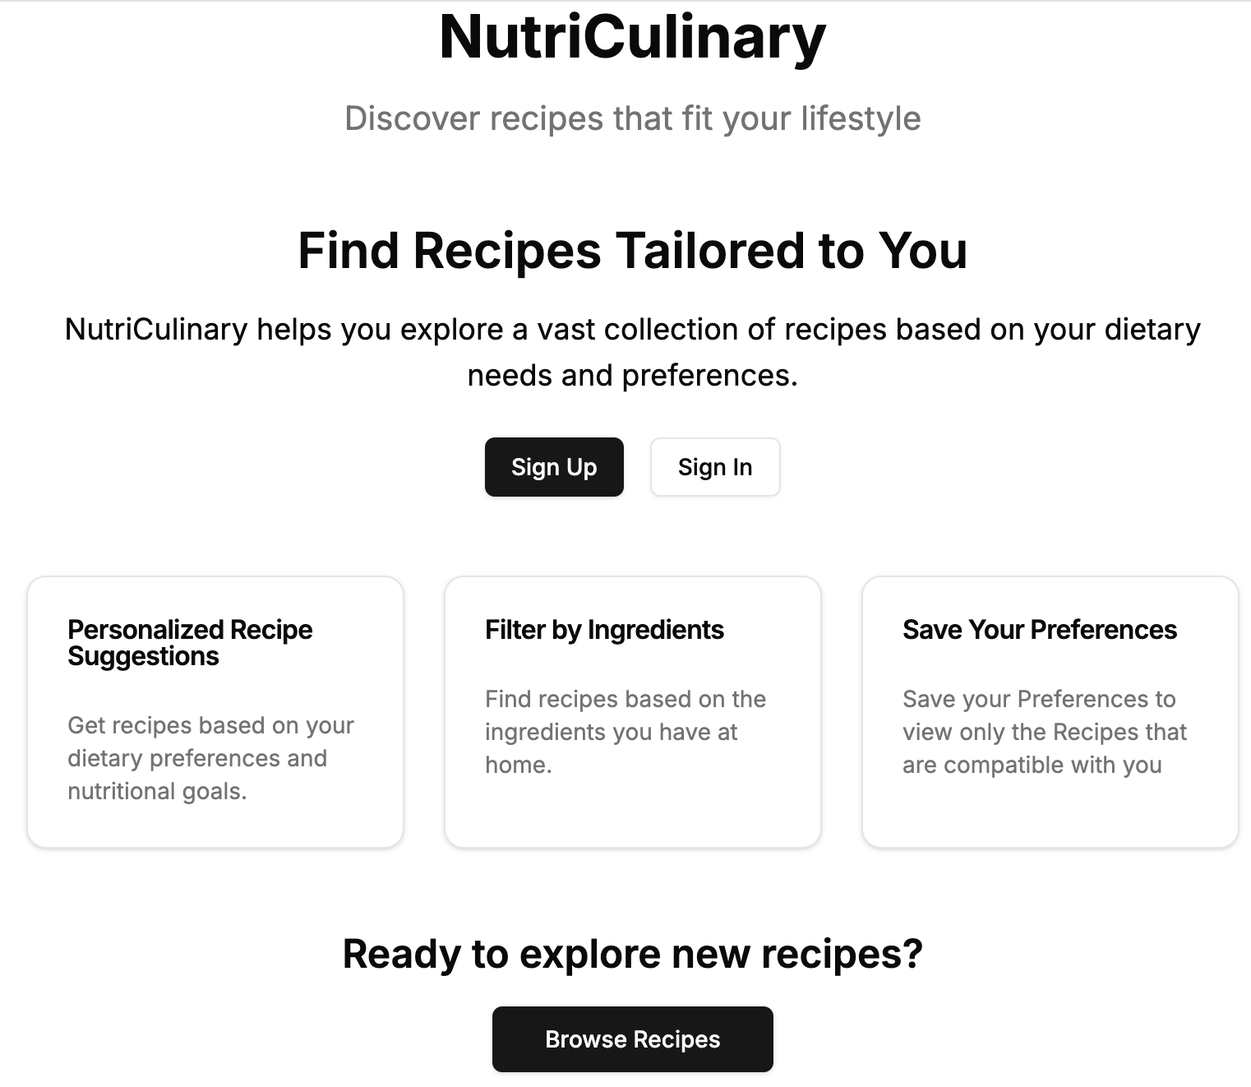
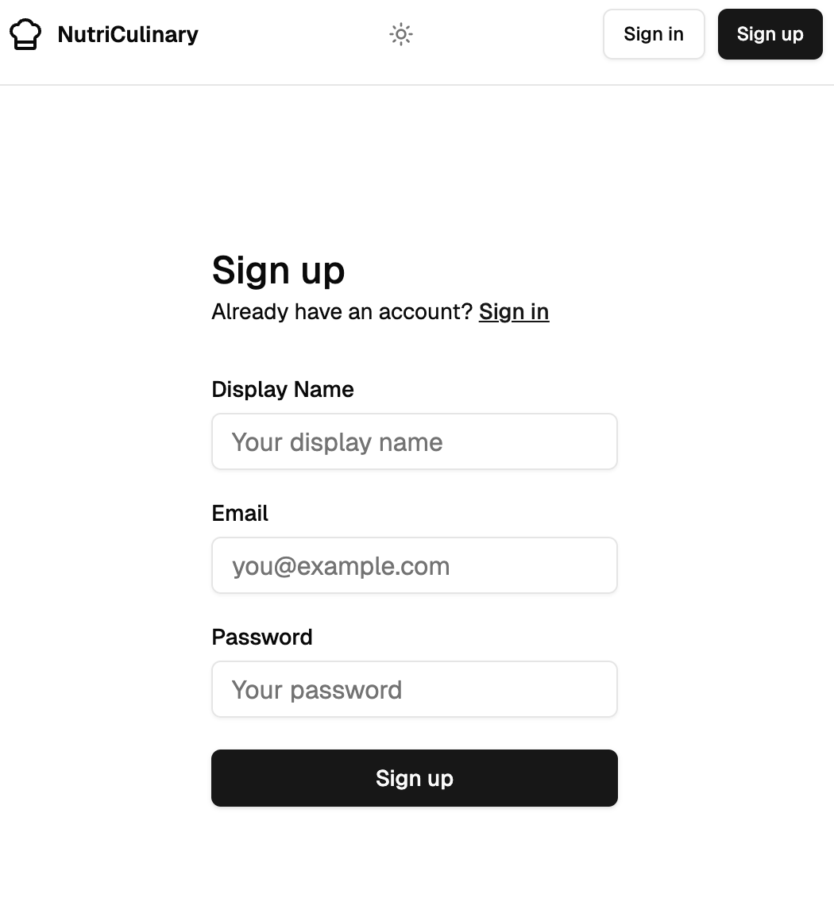
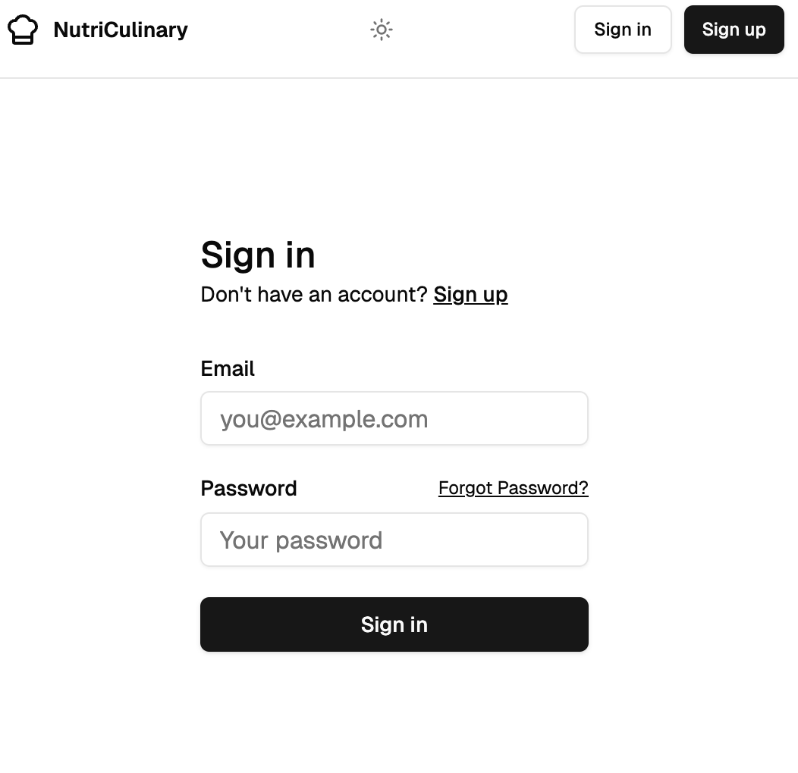
Website - Introductory, Sign Up and Sign In Page

Slide 7




Tech Stack
Database : Supabase (PostgreSQL)
Web Framework : Next.Js + Typescript
Deployment : Vercel
Version Control : Github

Slide 8
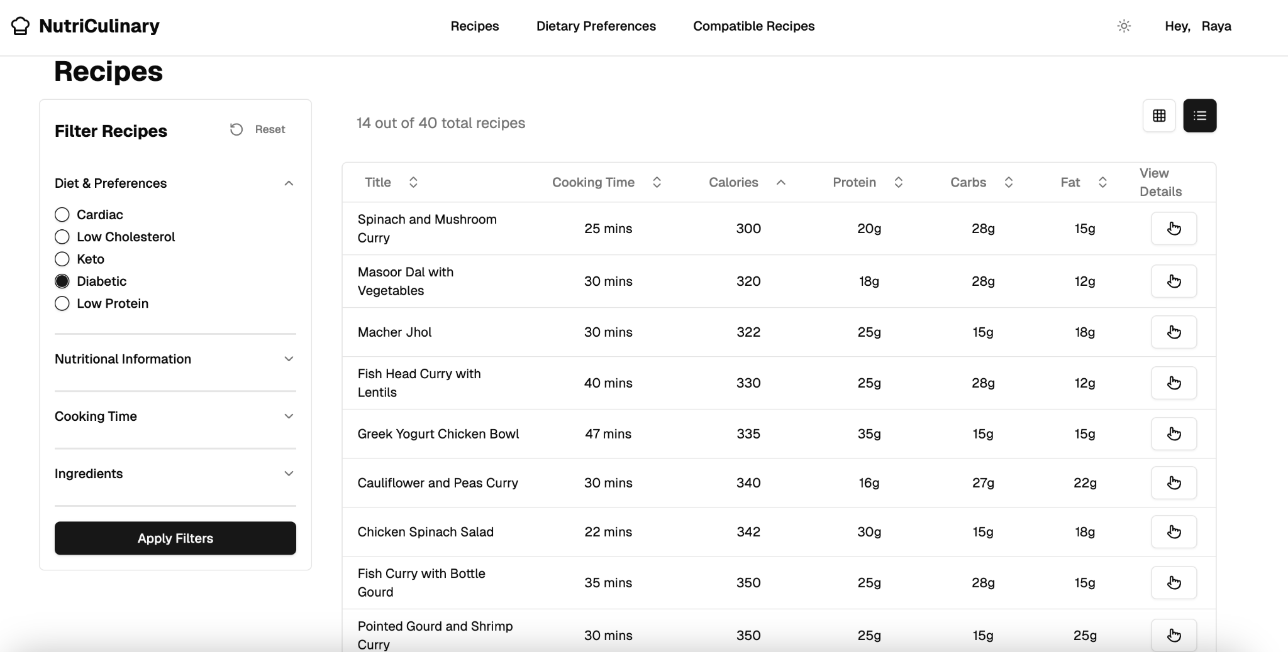
Website - Recipes Page
Use of Exists Clause with Sorting(Order By)

Slide 9
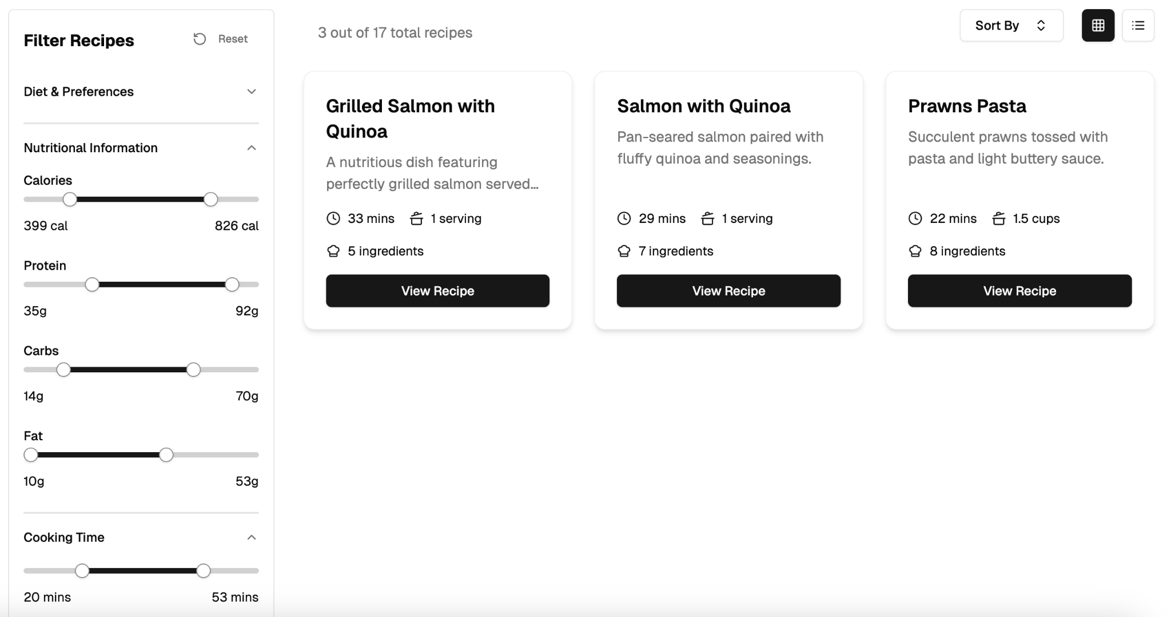
Website - Recipes Page
Use of Set Operations (Intersection)

Slide 10
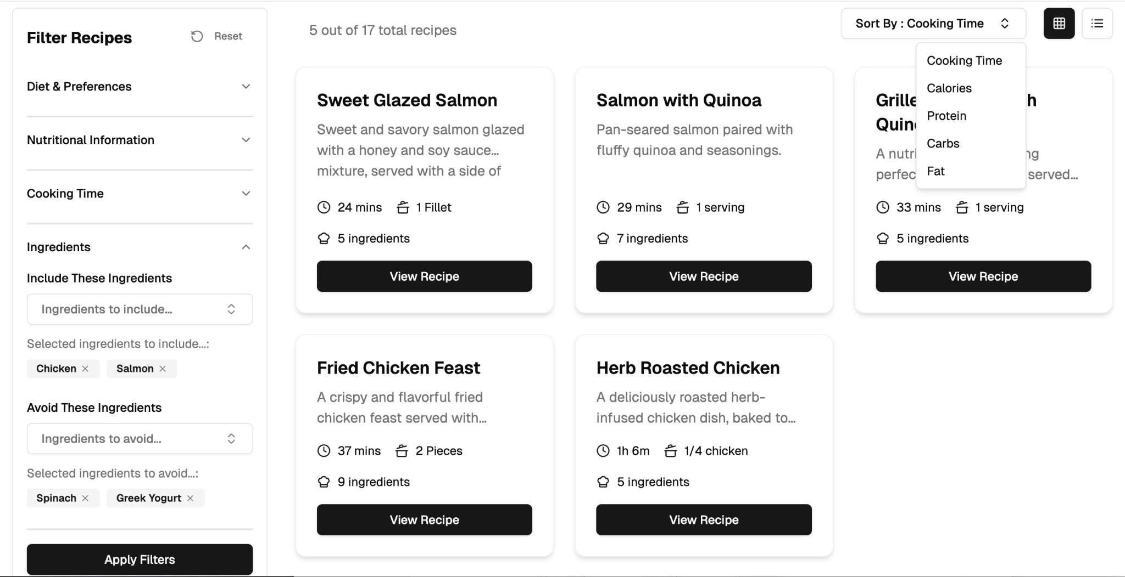
Website - Recipes Page
Use of Set Operations (Except or Minus) with Sorting (Order By)

Slide 11
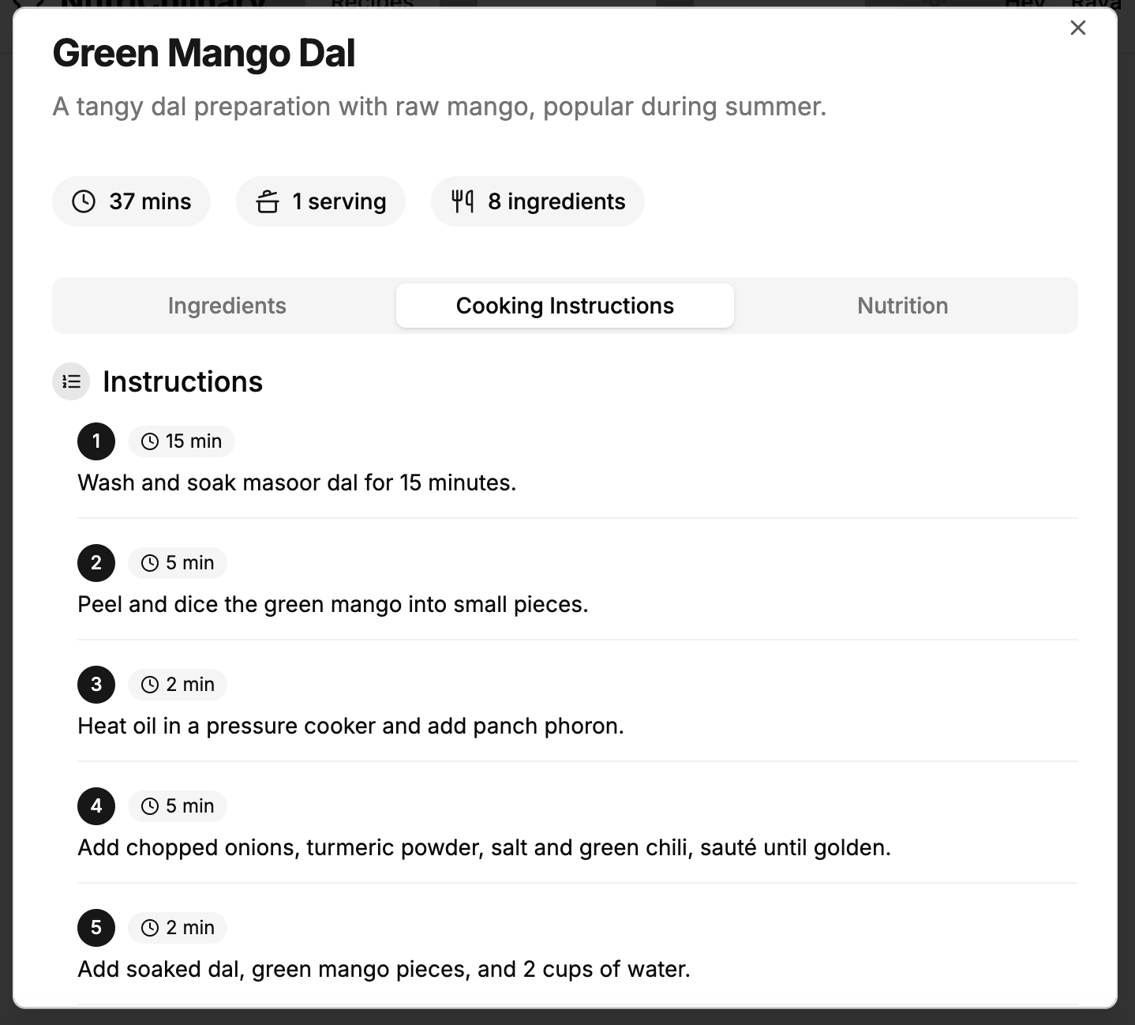
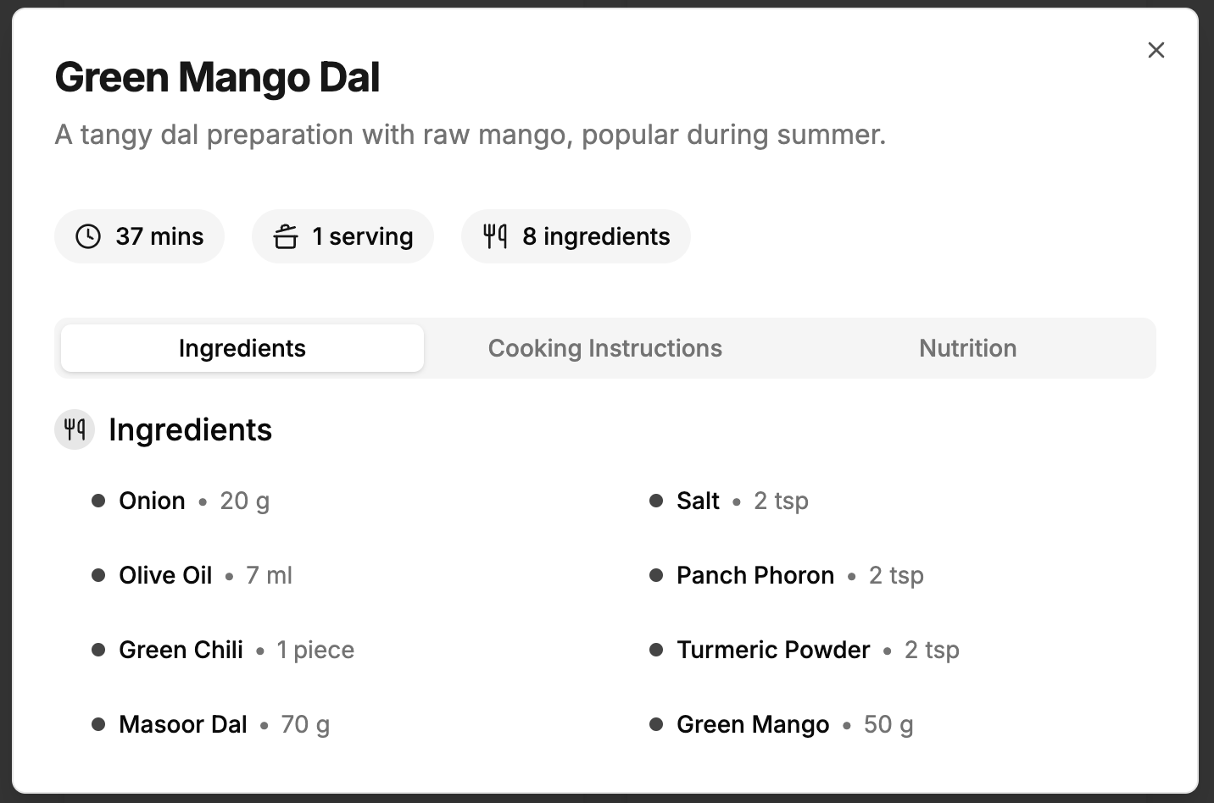
Website - Recipe Details Dialogue Box
Use of Natural Join Use of With Clause

Slide 12
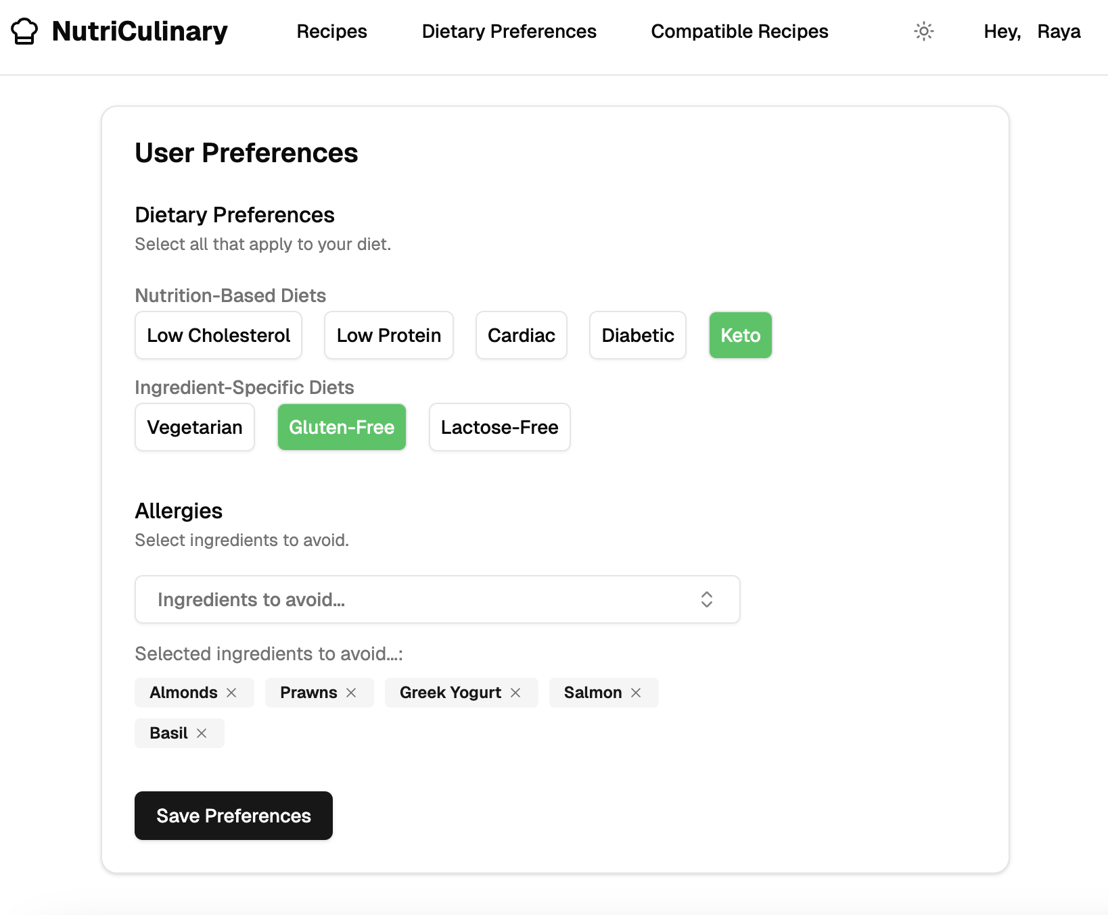
Website - User’s Dietary Preferences Update

Slide 13
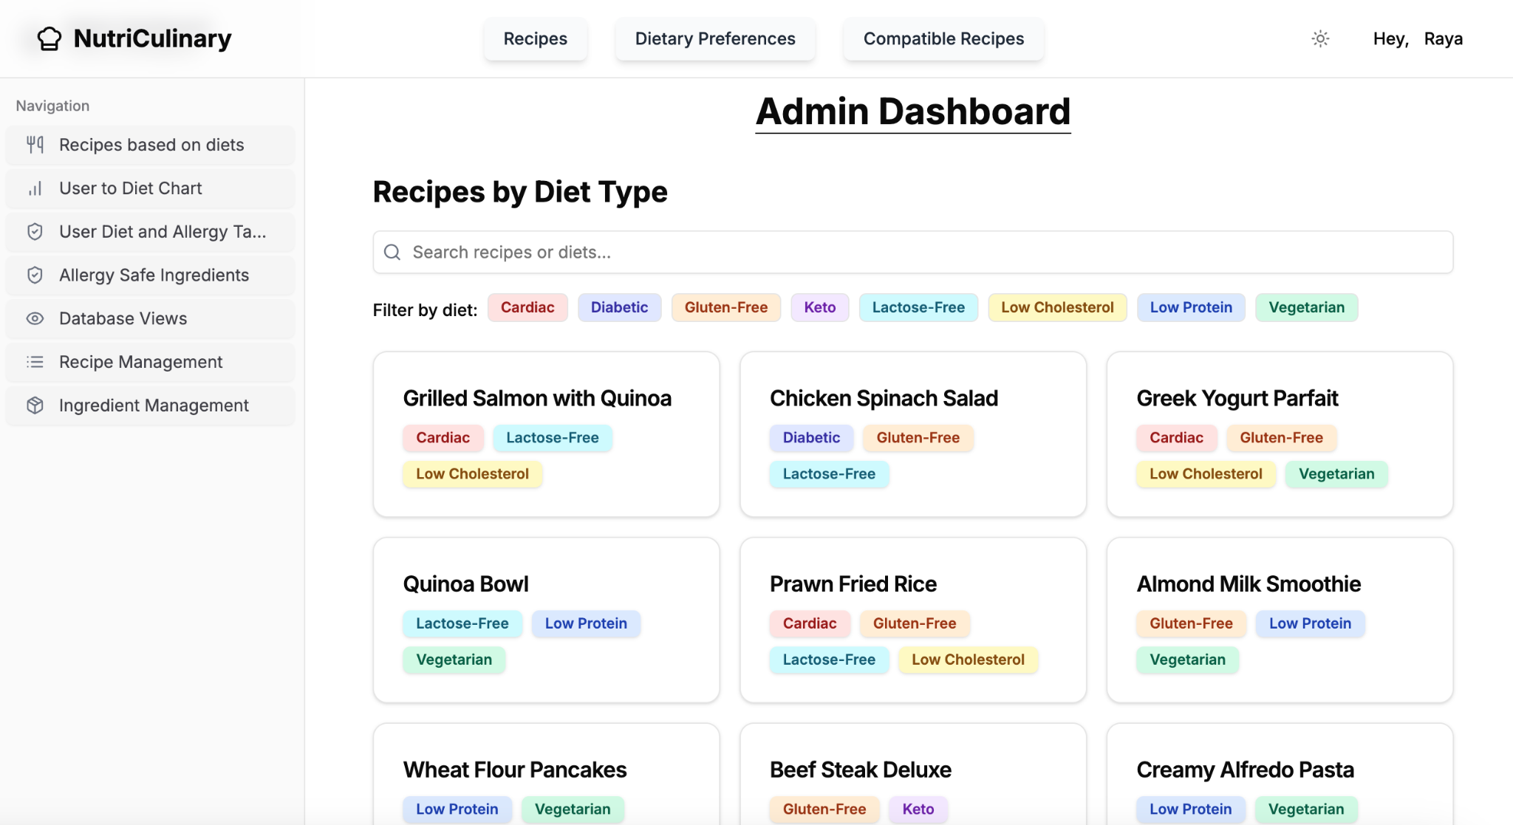
Website - Admin Page
Use of Cross Product with Conditions

Slide 14
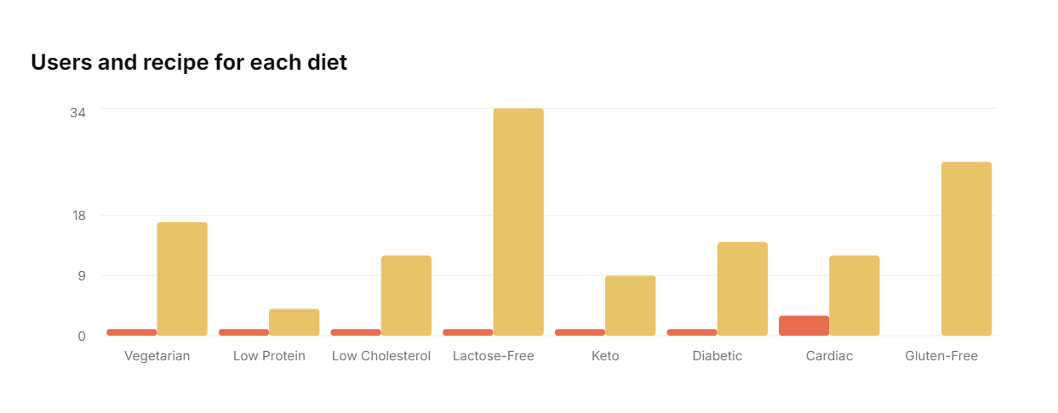
Website - Admin Page
Use of Group By, Having and Count()

Slide 15
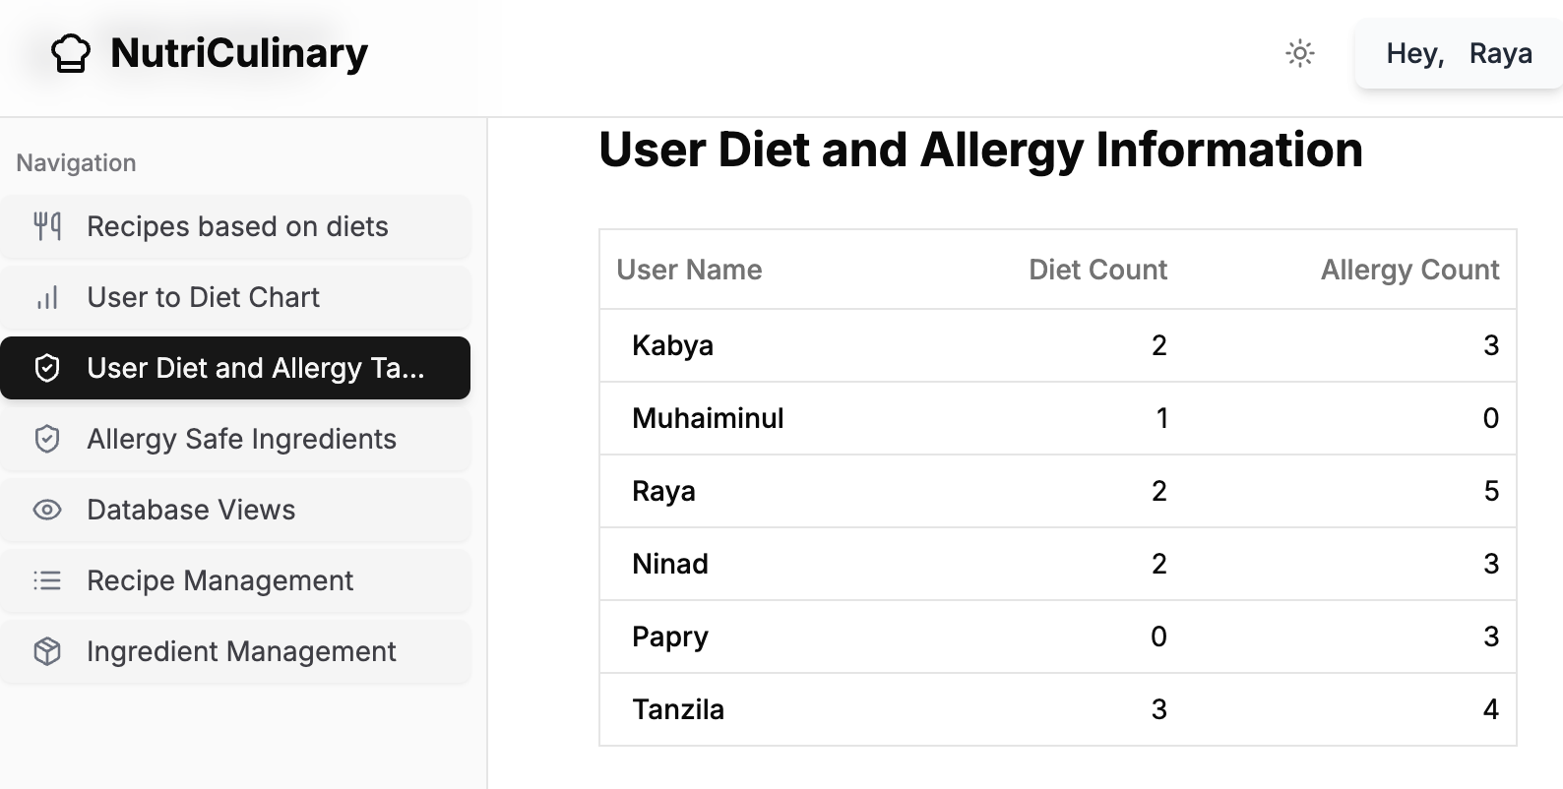
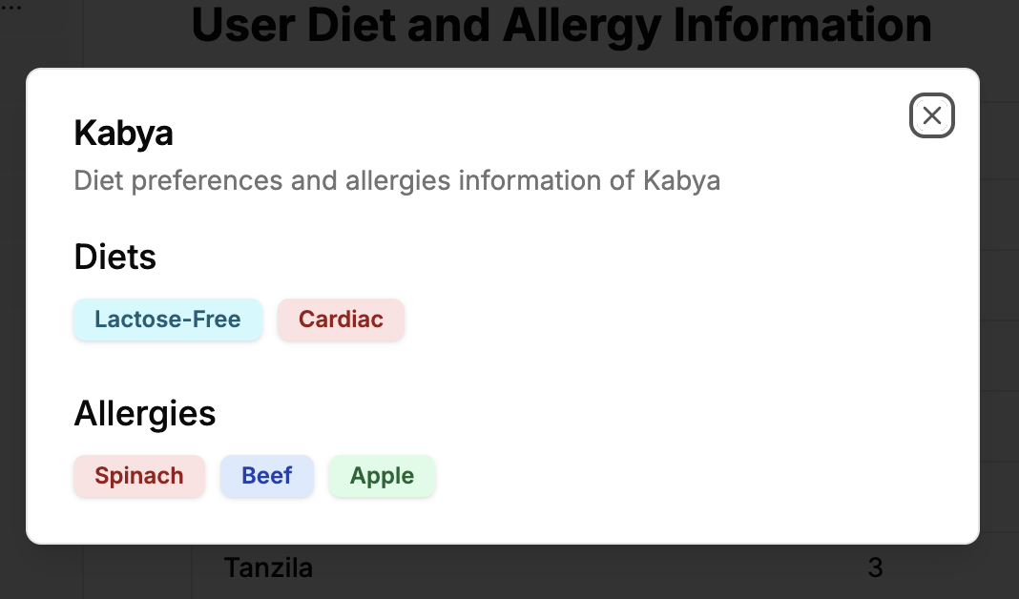
Website - Admin Page
Use of Scalar Sub-Query Use of Outer Join

Slide 16
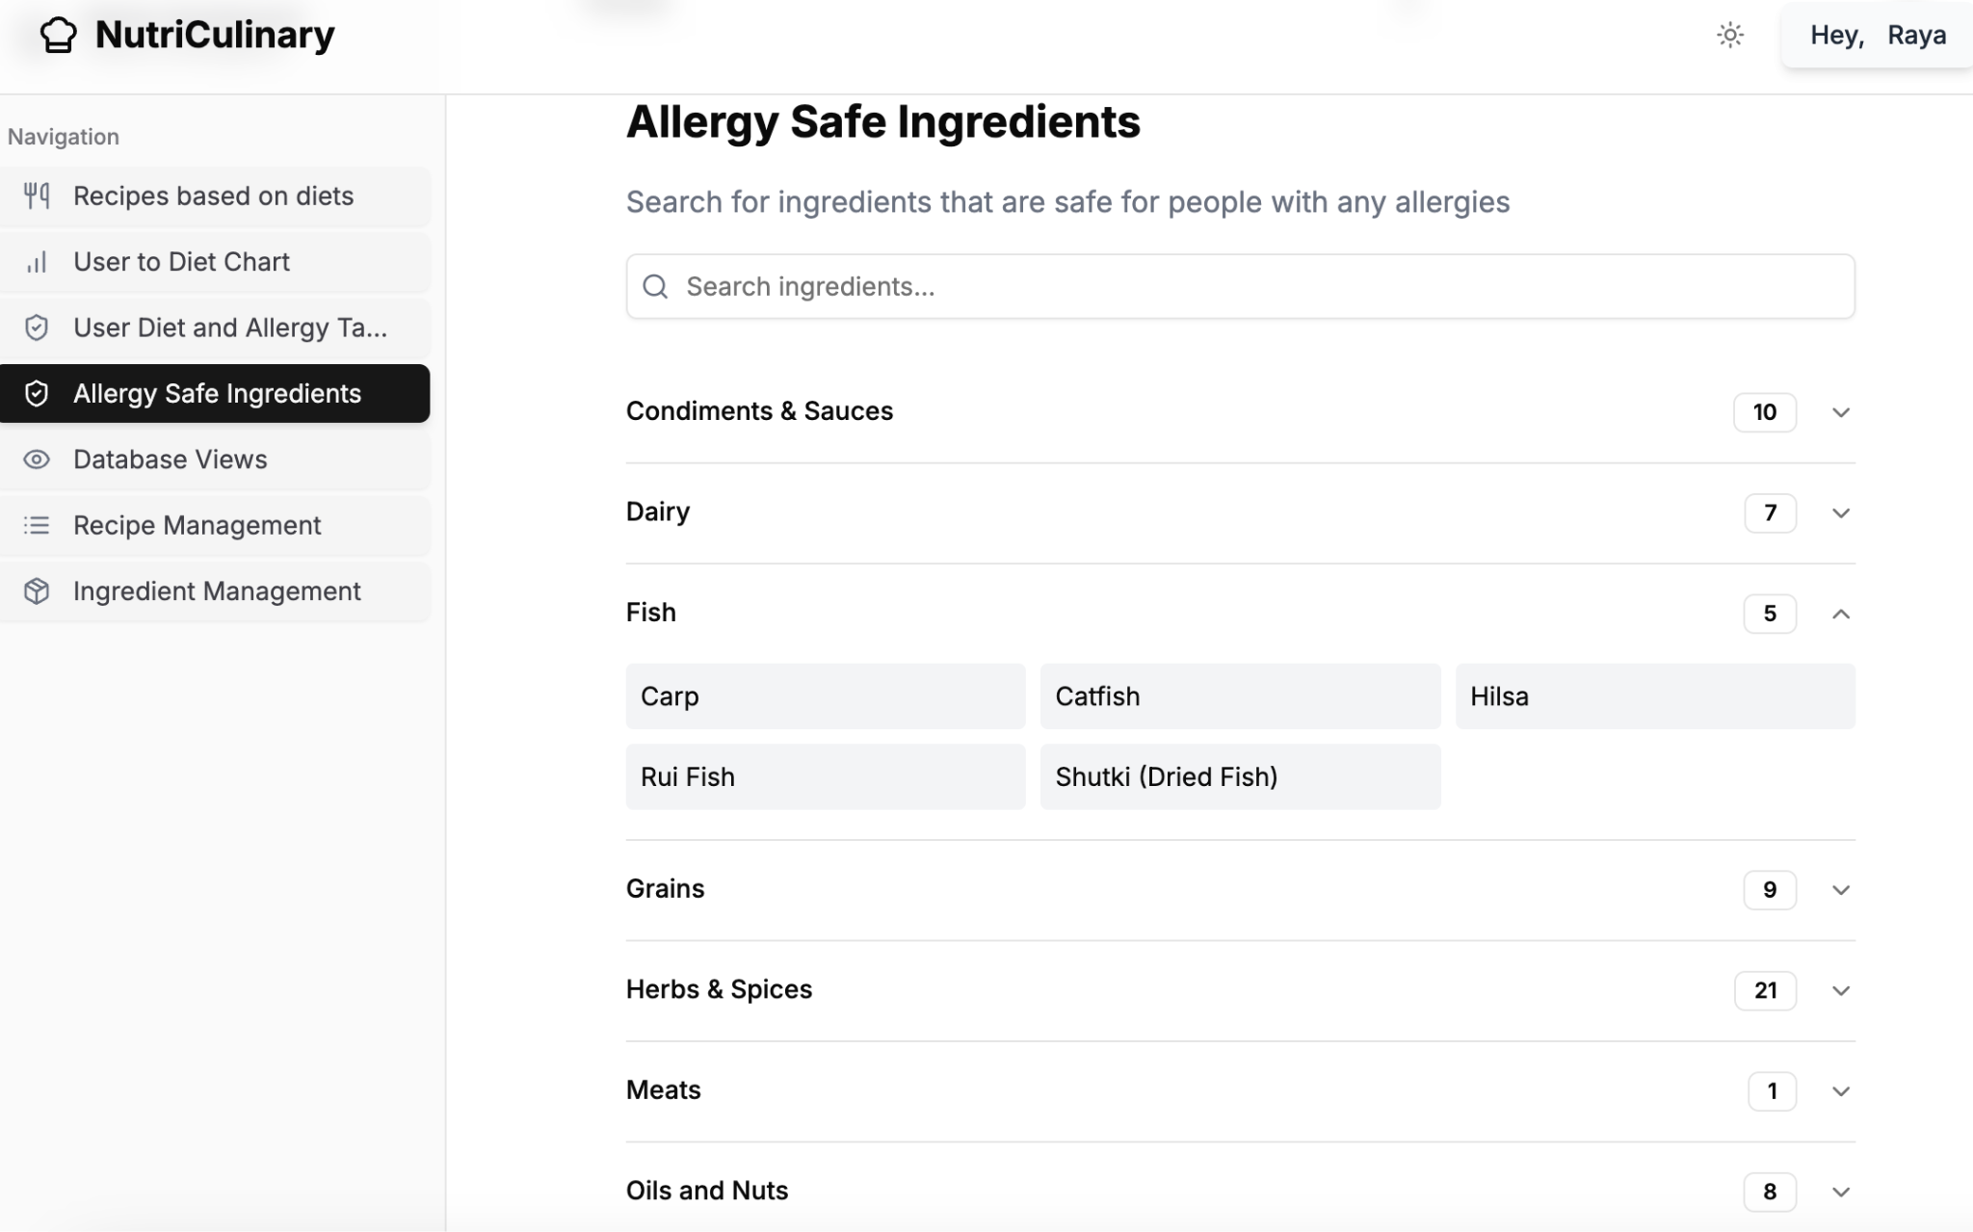
Website - Admin Page
Use of All Clause and Not Equal

Slide 17
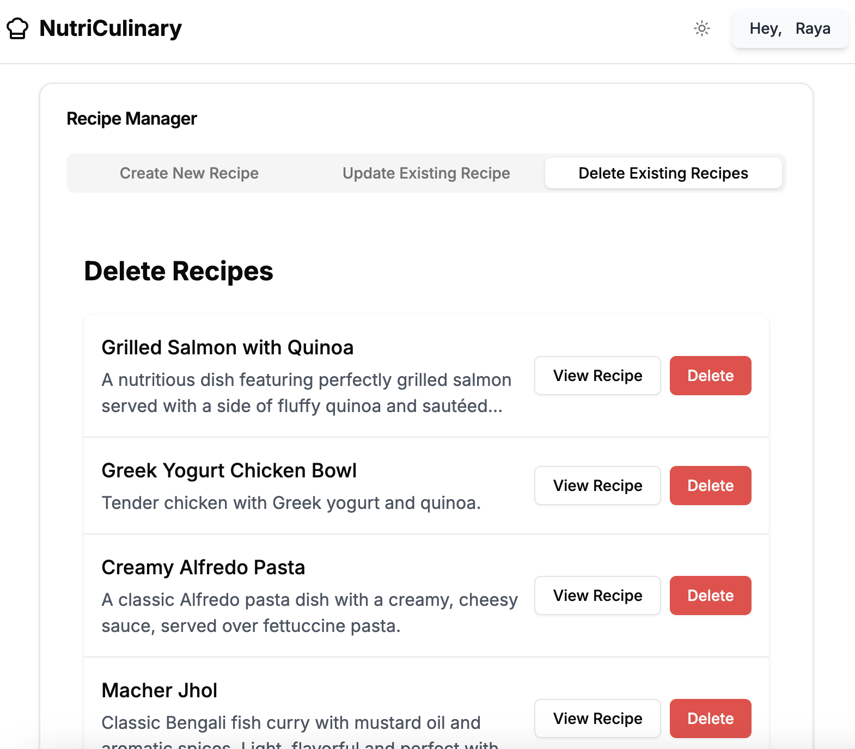
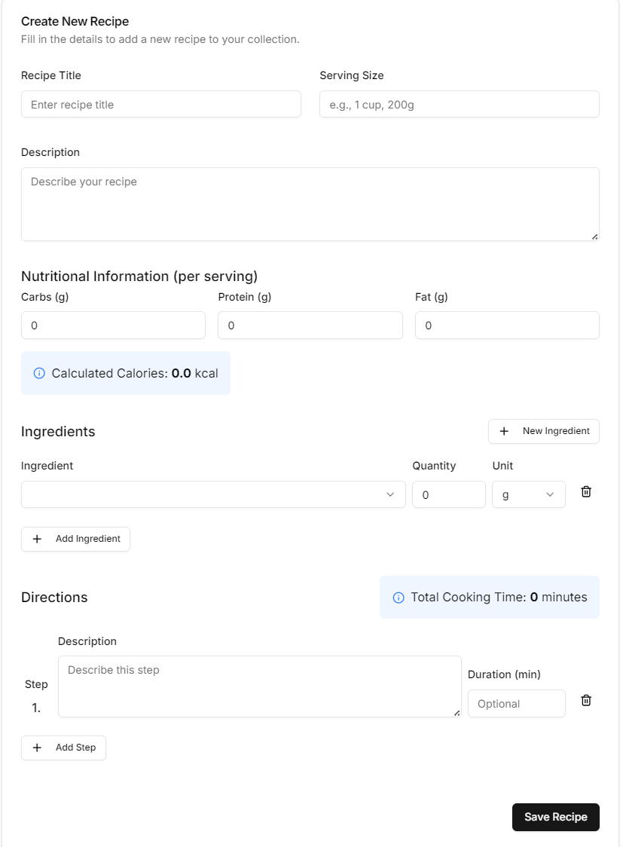
Website - Recipe Management
Insert Operation Delete Operation

Slide 18
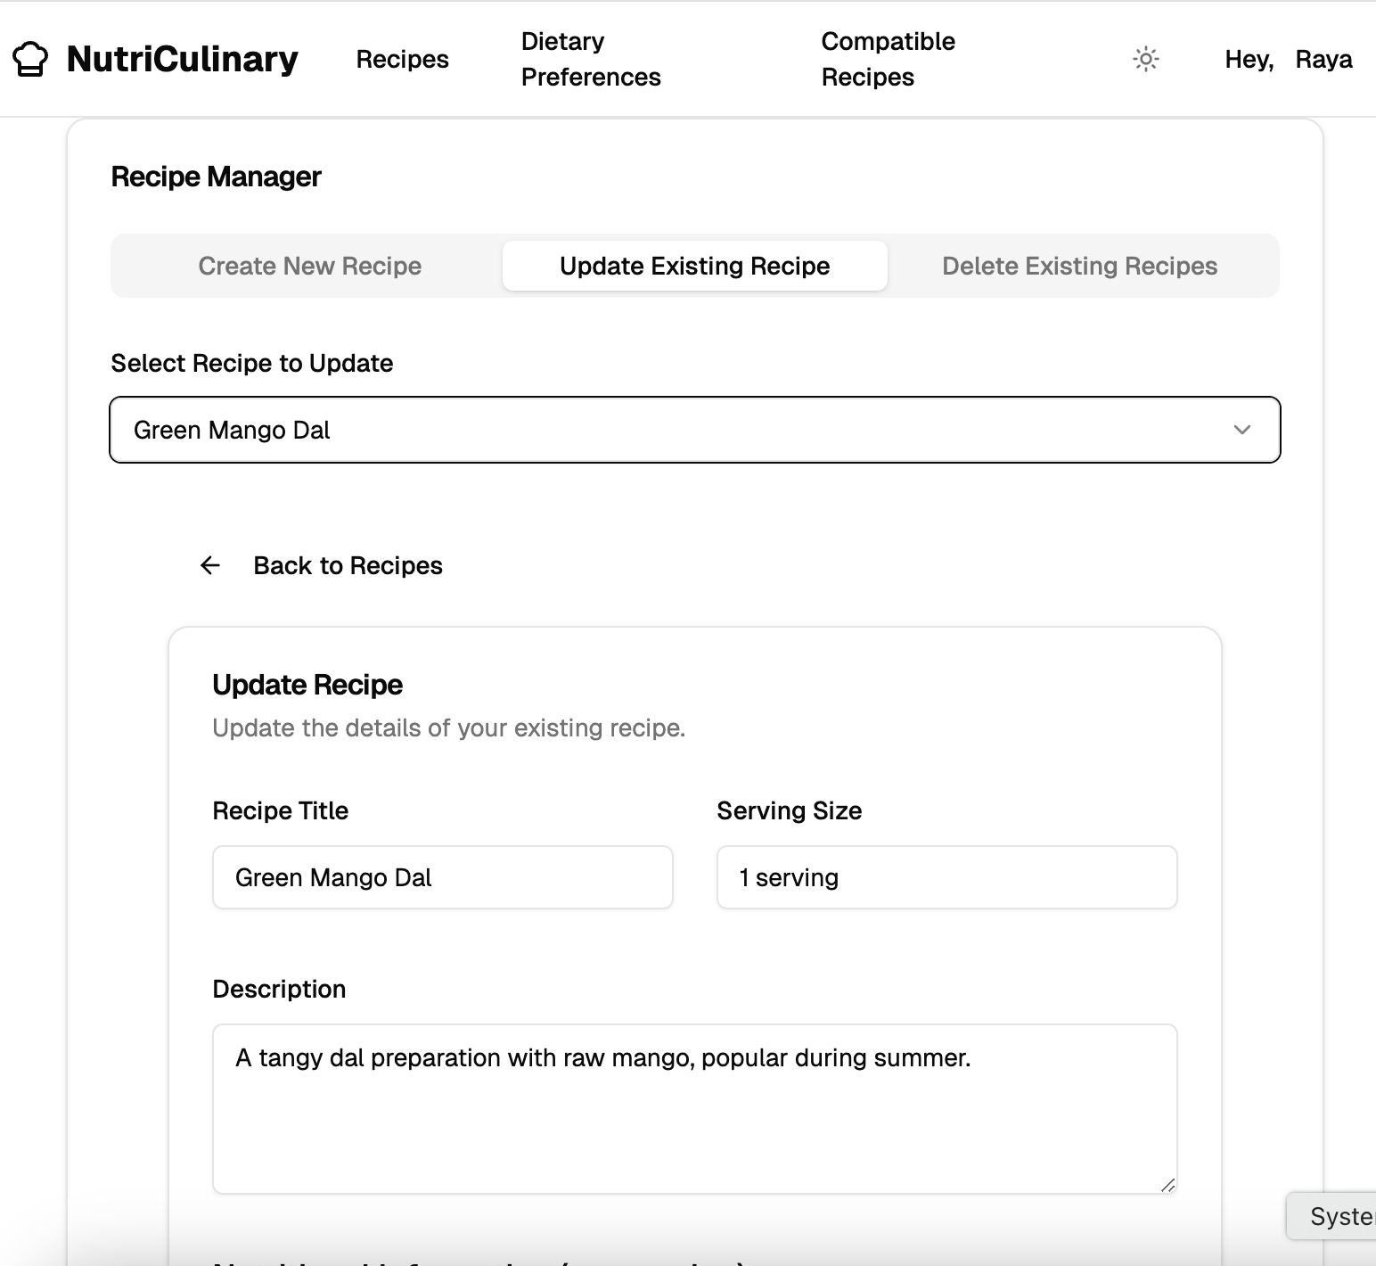
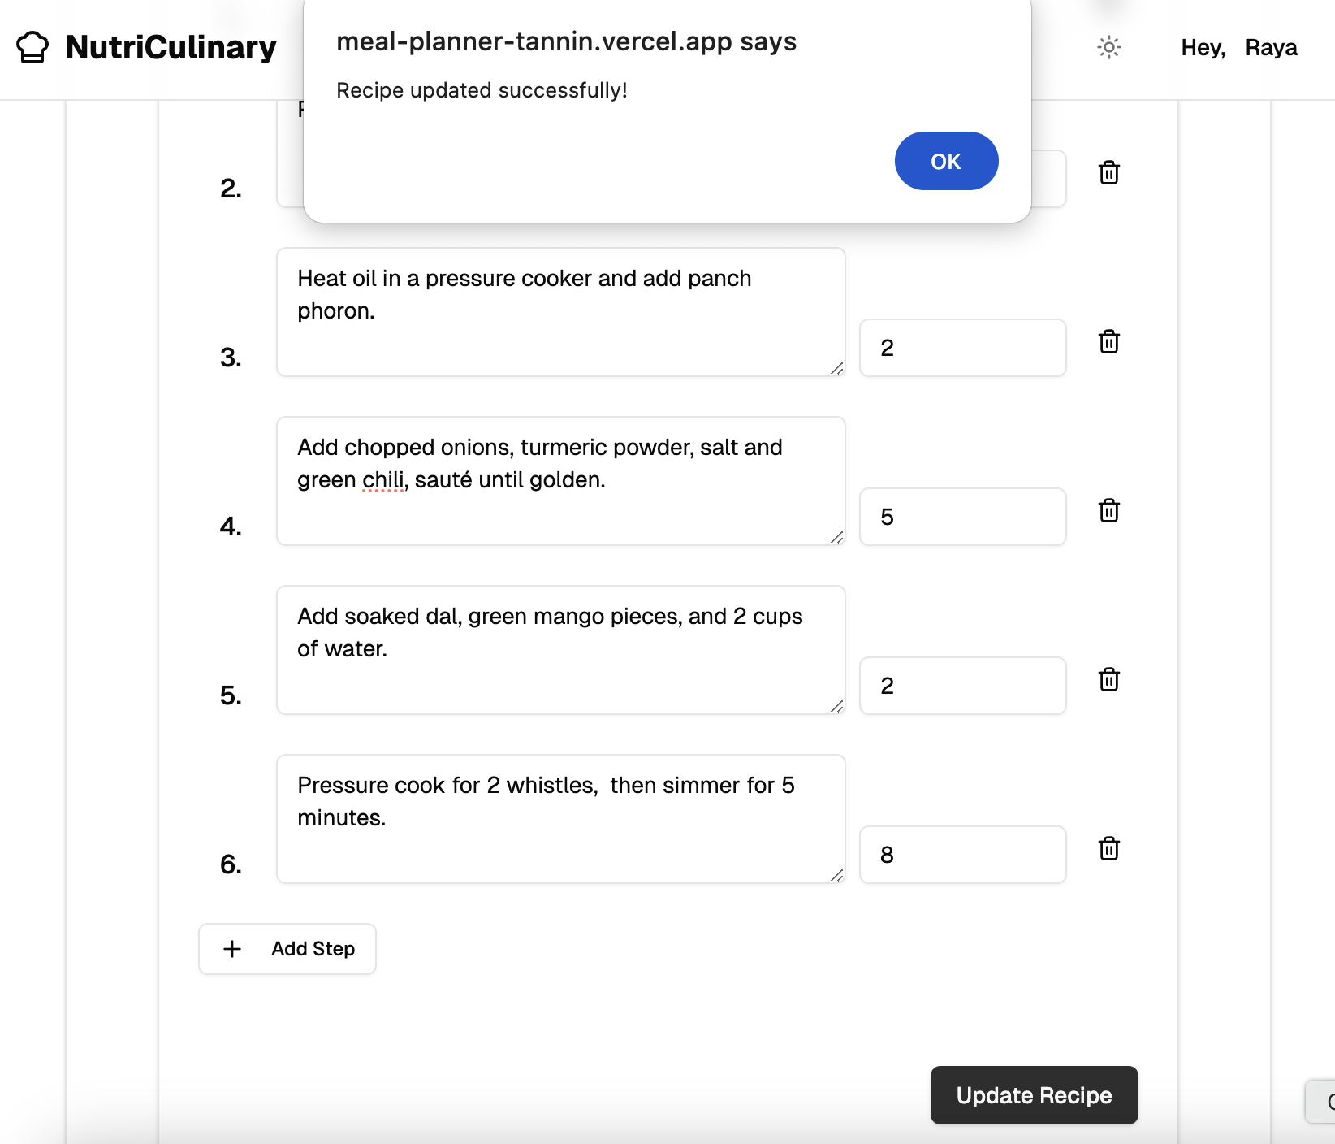
Website - Recipe Management
Update Operation

Slide 19
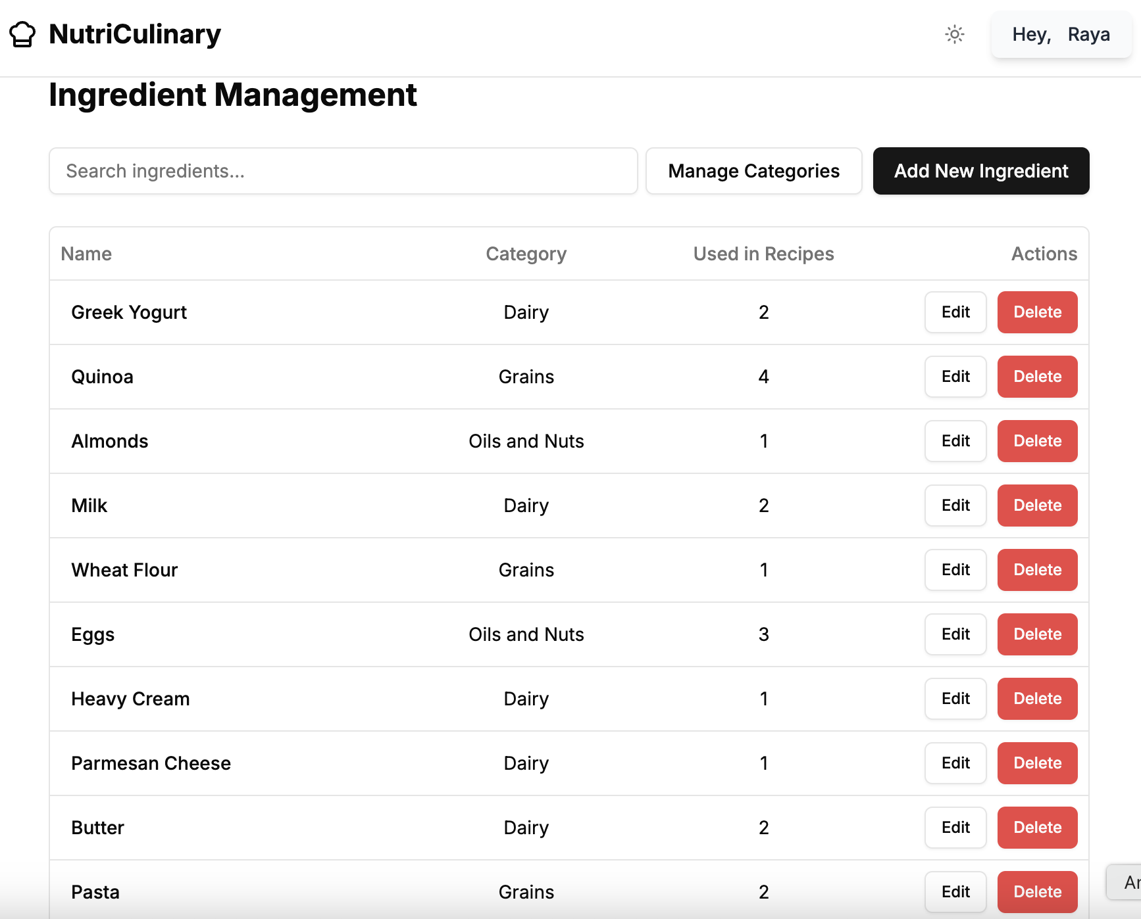
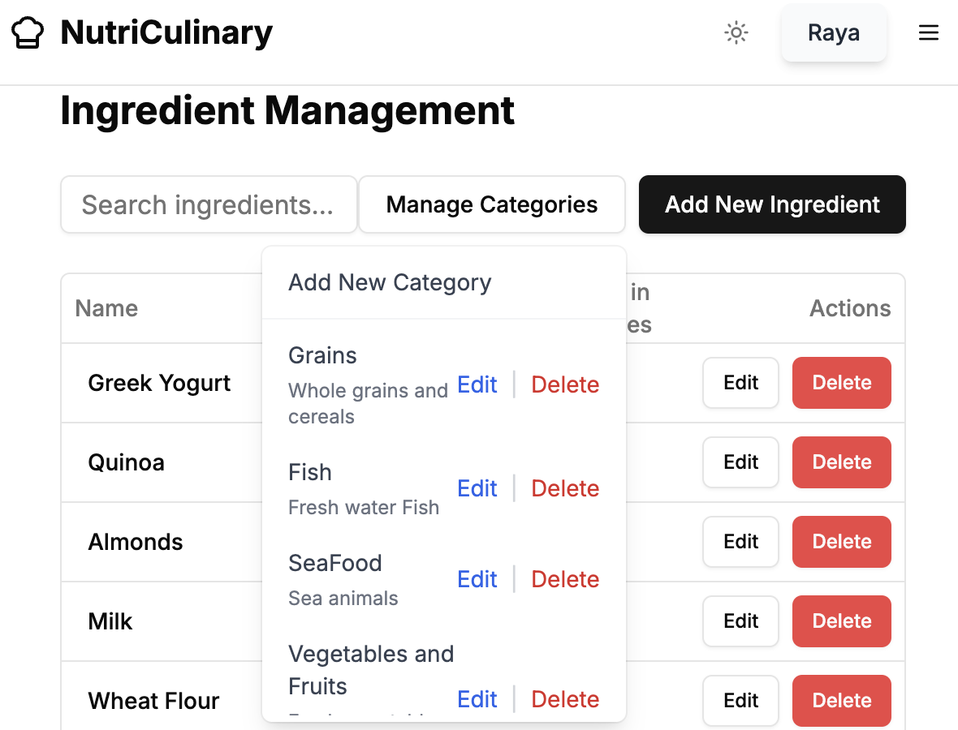
Website - Ingredient Management

Slide 20
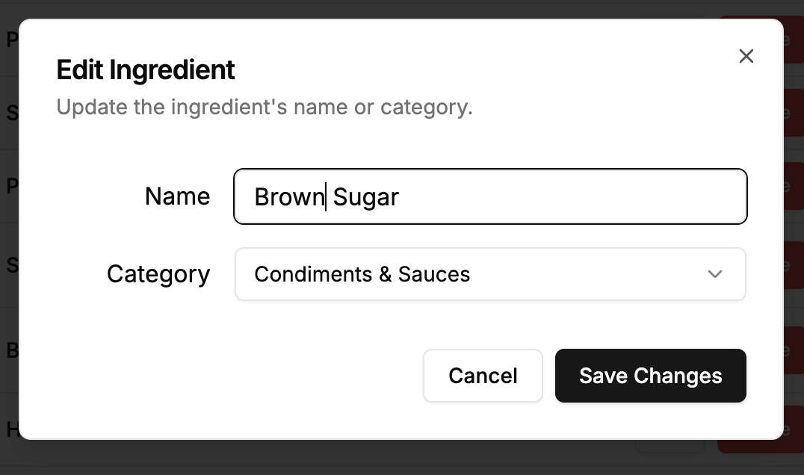
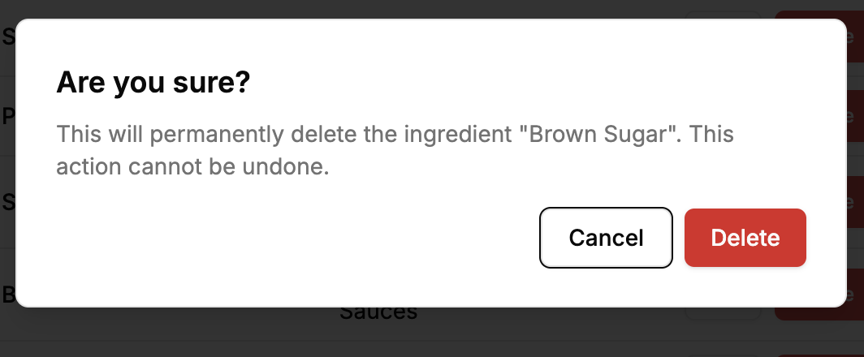
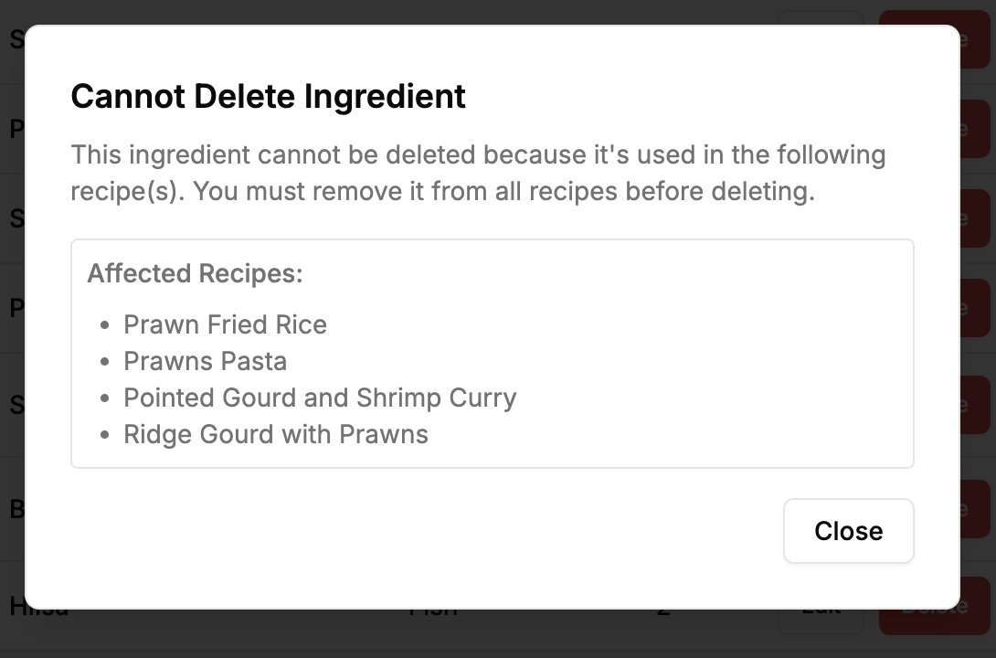
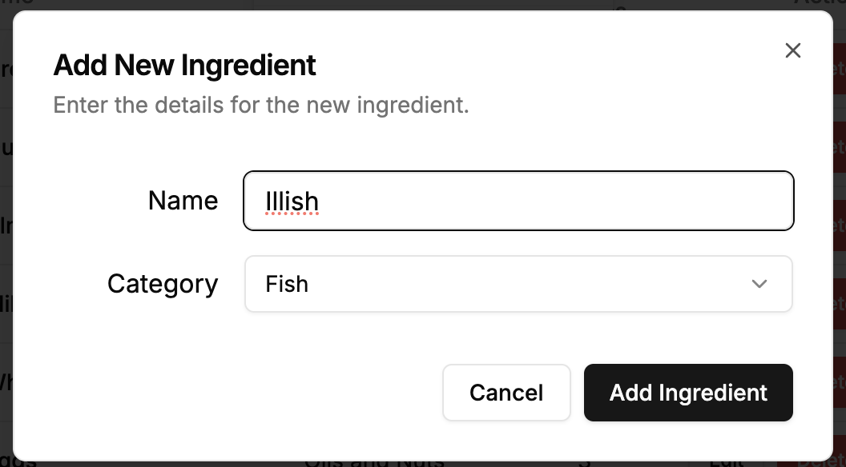
Website - Ingredient Management

Slide 21
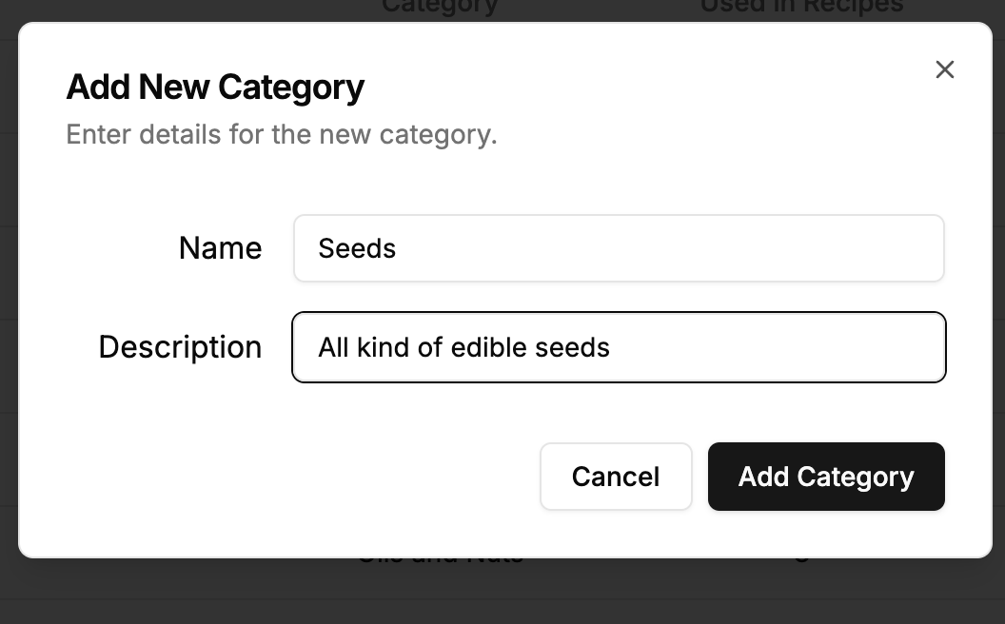
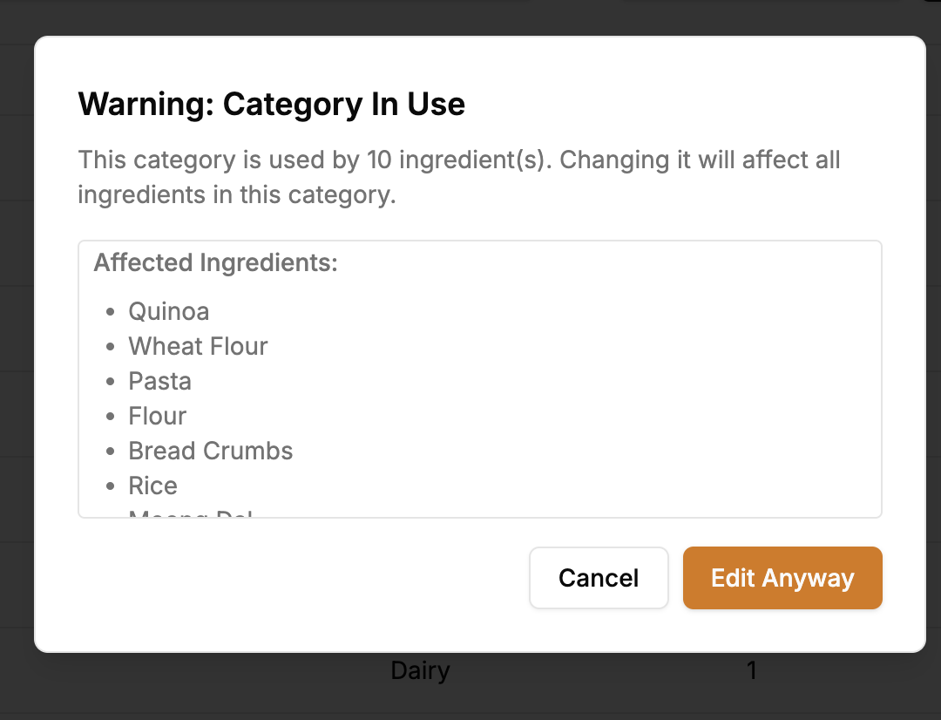
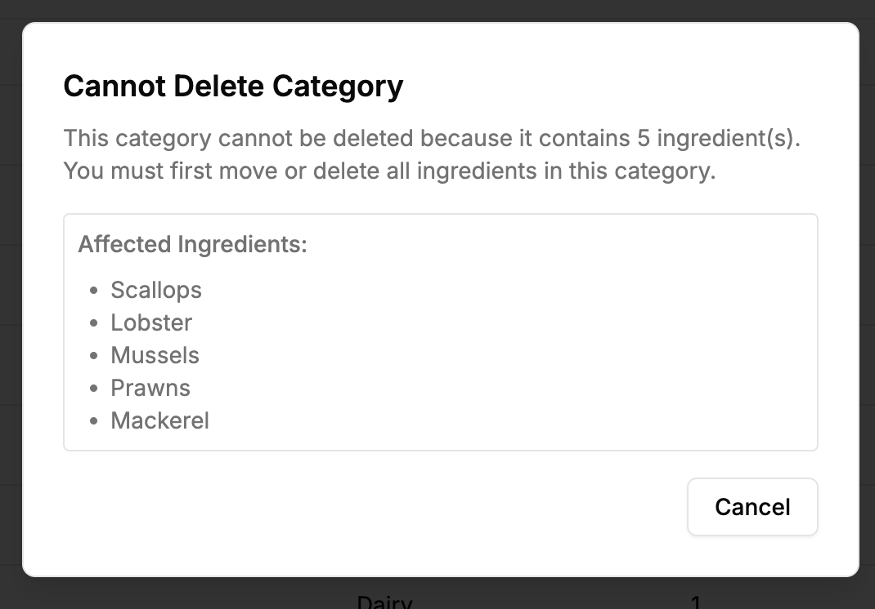
Website - Ingredient Management

Slide 22
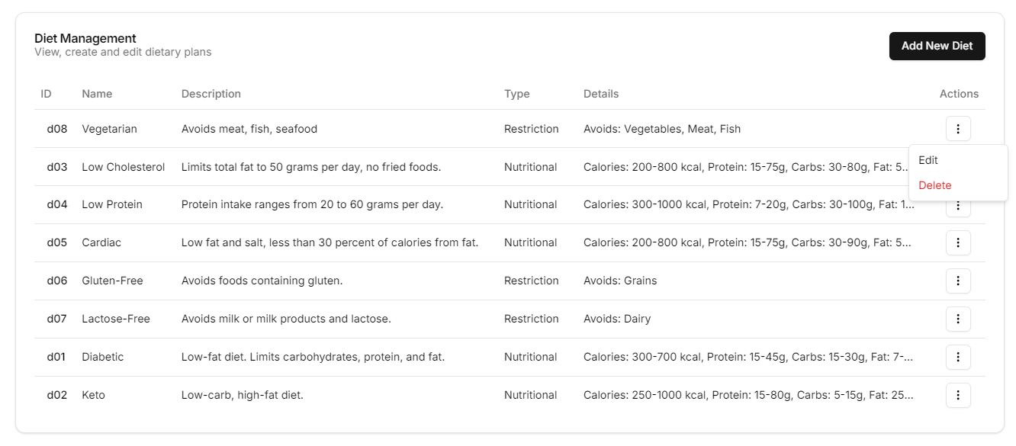
Website - Diet Management

Slide 23
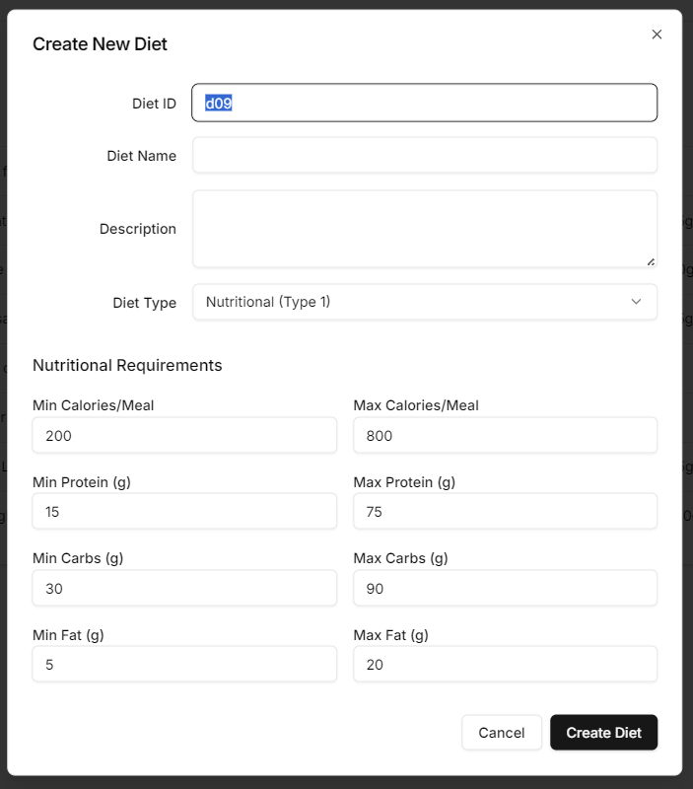
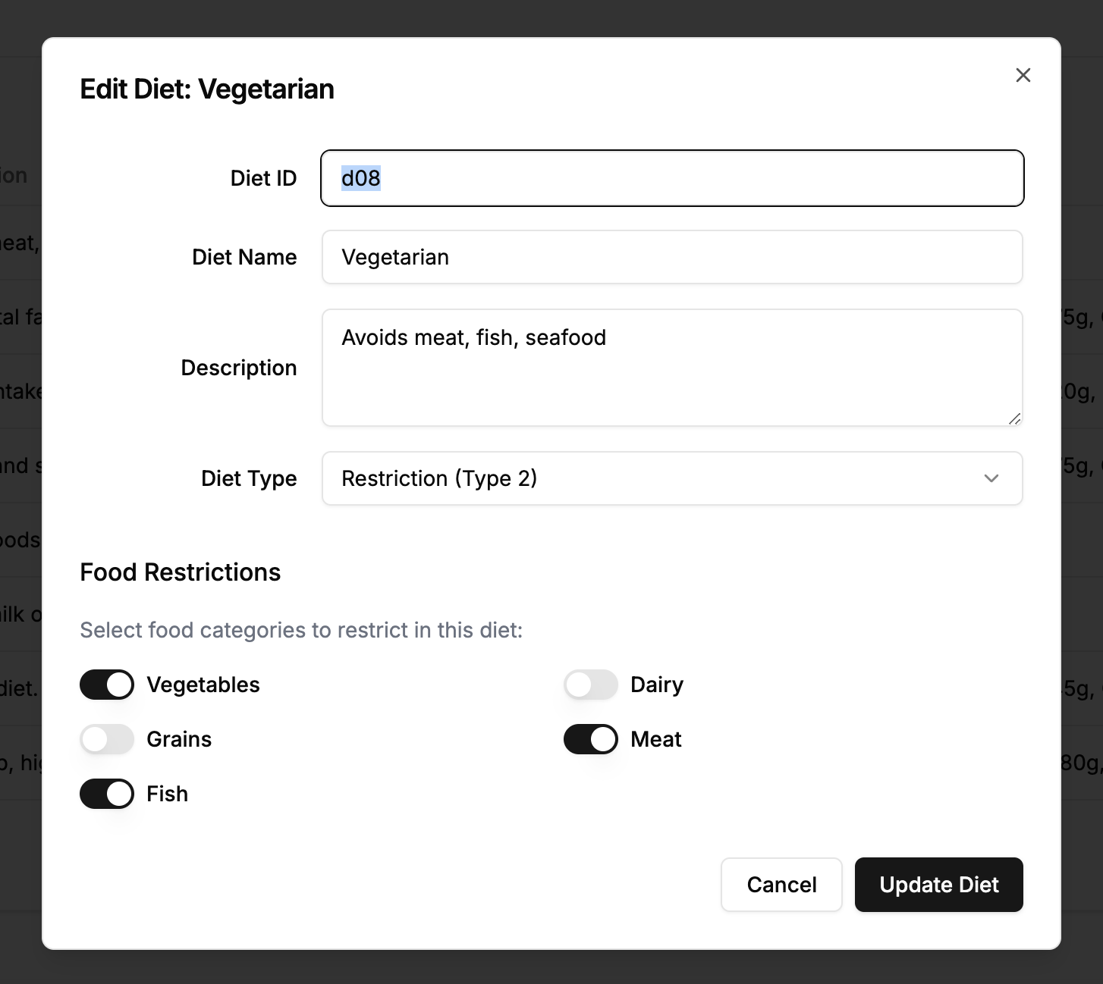
Website - Diet Management

Slide 24
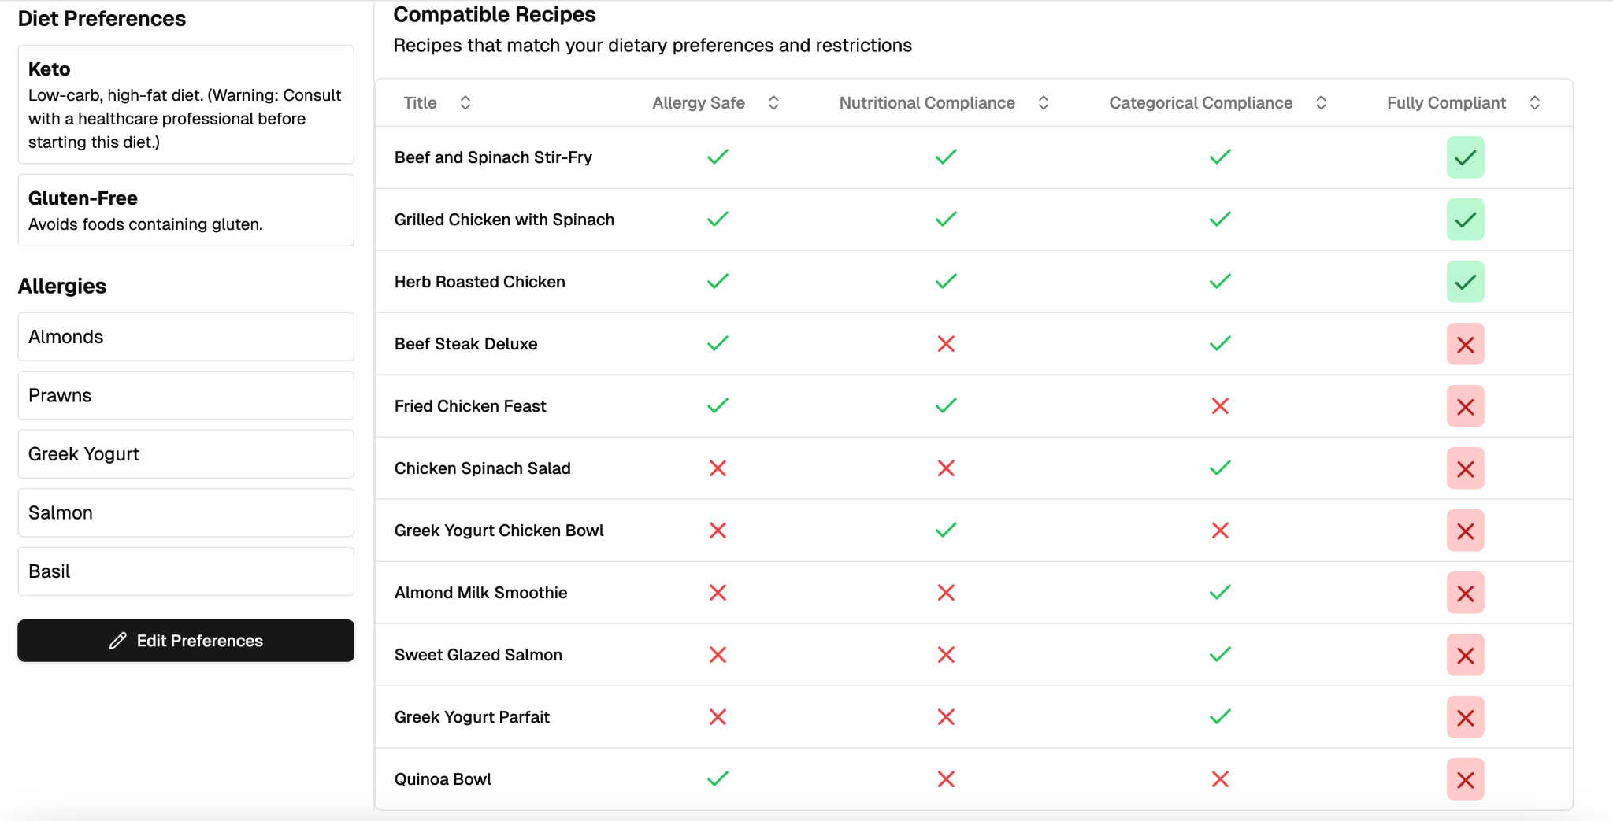
Website - Compatible Recipe For User
Using Previously Created Views within a PostgreSQL Function

Slide 25
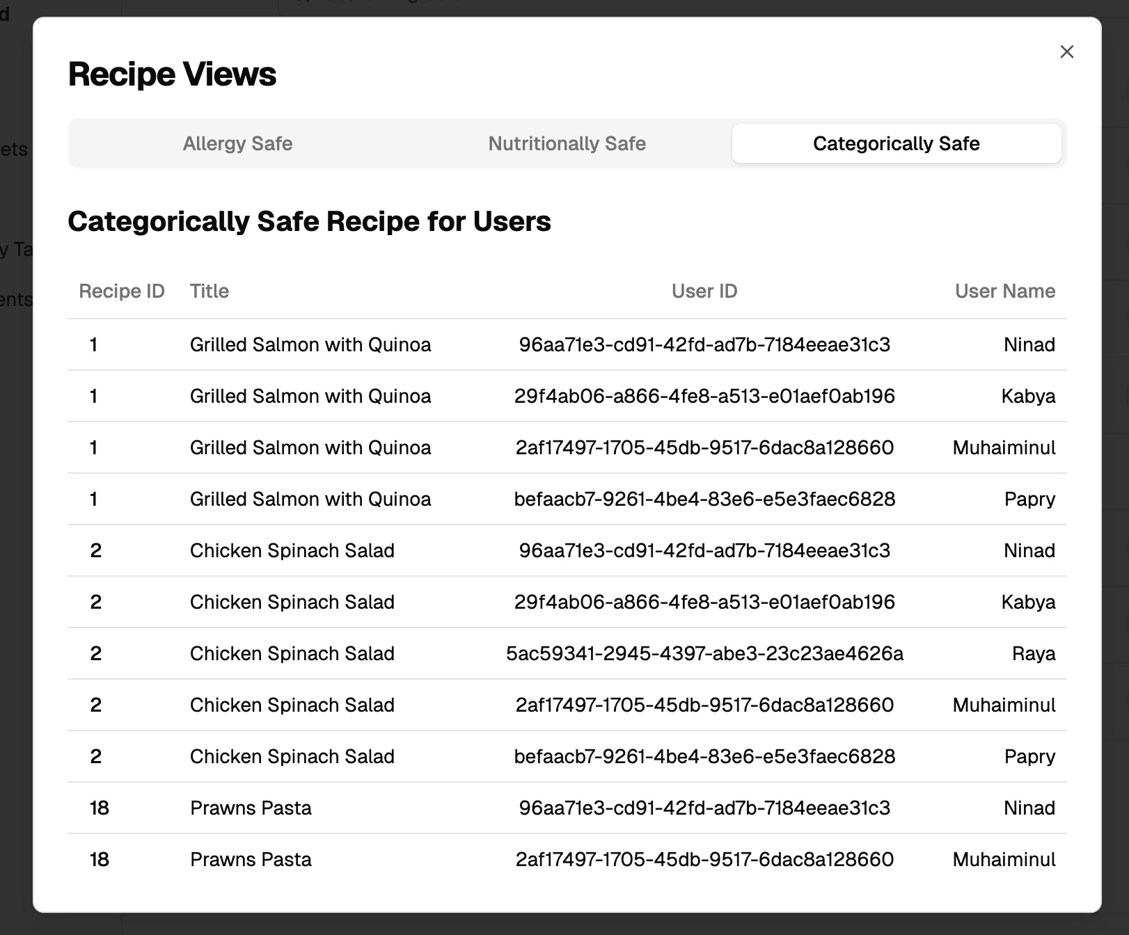
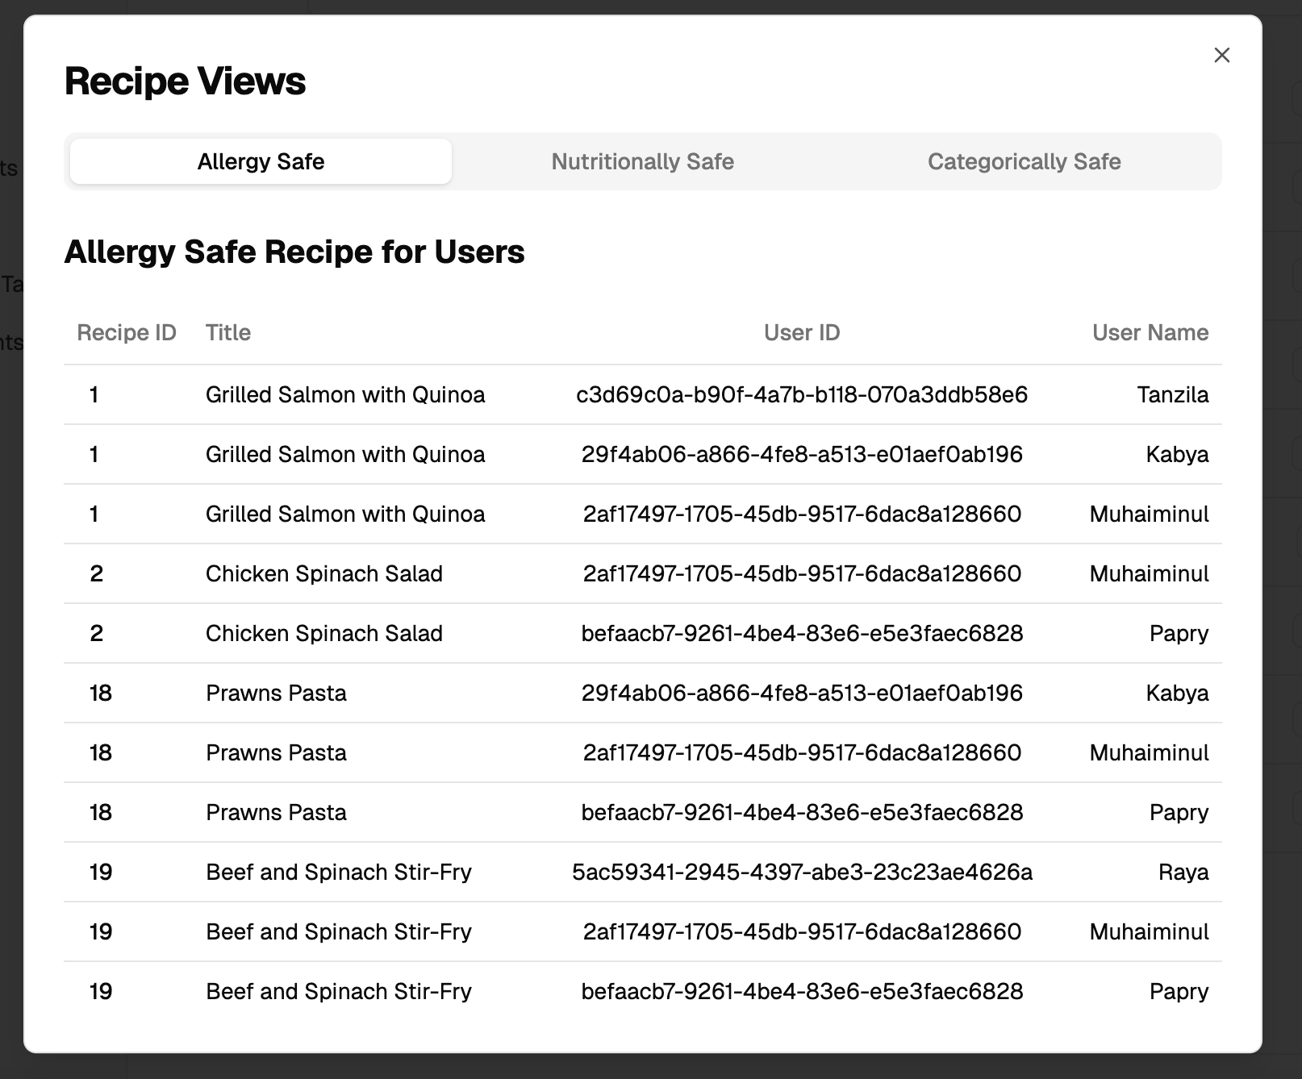
Website
Showing Created View(Using Nested Subquery, Not Exists Clause and Cross Join)

Slide 26
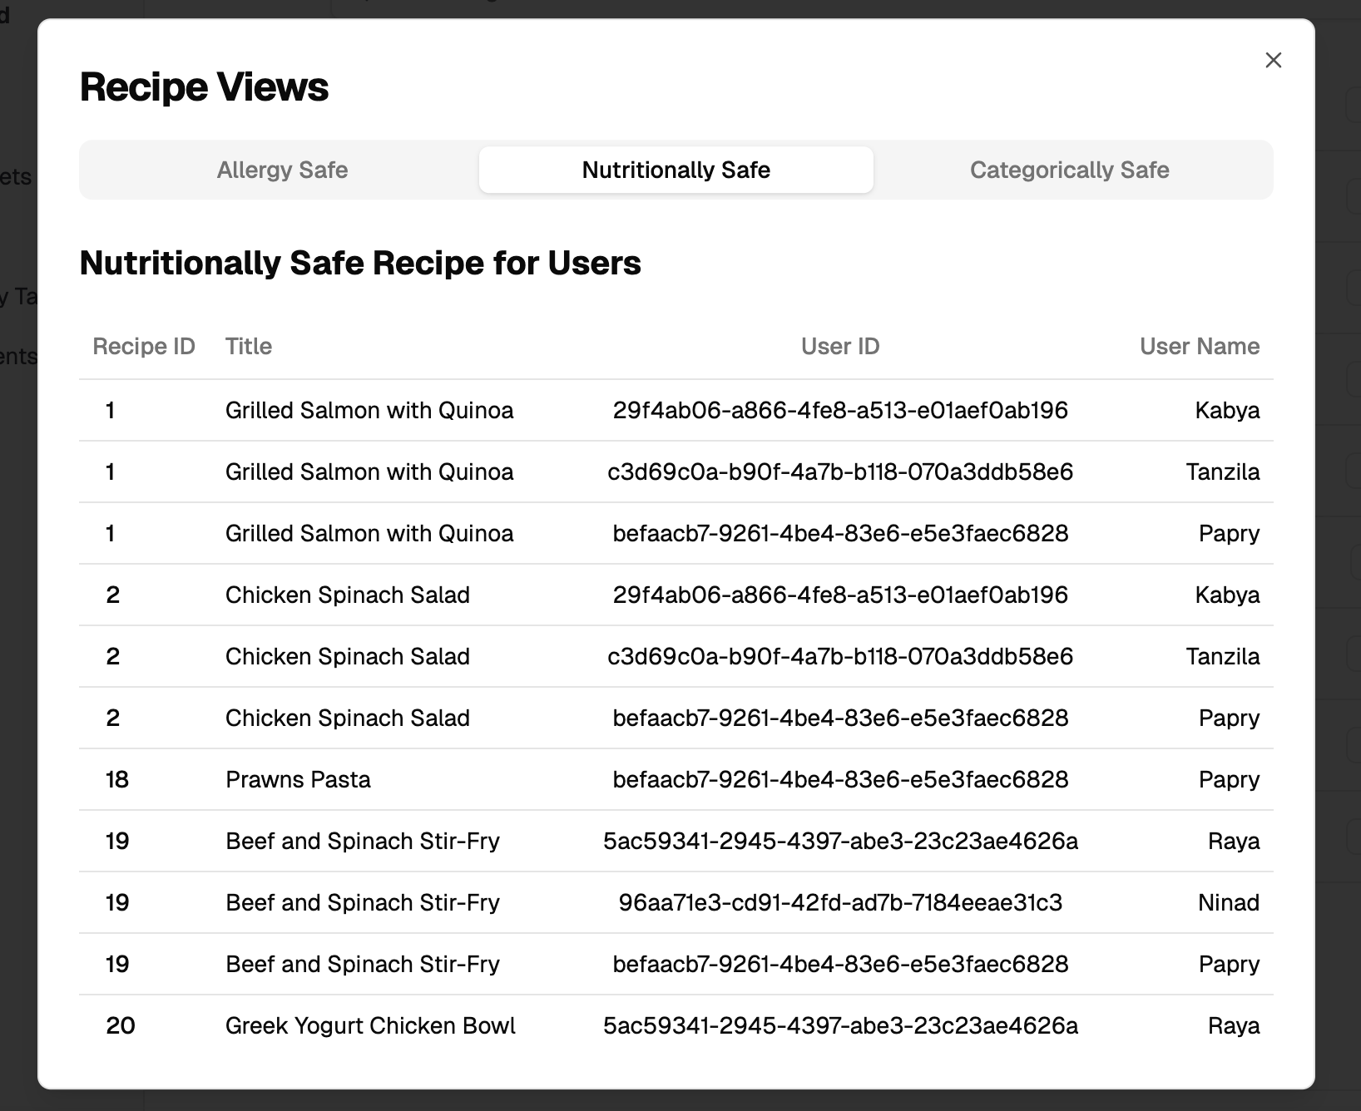
Website
Showing Created View (Using With Clause and Case Statement)

